Slide 1

Homework 5 Password Hashing INT4023
Dalton Murray

Slide 2
Hashes

Slide 3
List 1
Local Admin,7C4A8D09CA3762AF61E59520943DC26494F8941B,123456
Domain Admin,8BE3C943B1609FFFBFC51AAD666D0A04ADF83C9D,Password
Master encryption,7C222FB2927D828AF22F592134E8932480637C0D,12345678
MDM,B1B3773A05C0ED0176787A4F1574FF0075F7521E,qwerty
Company Twitter,8CB2237D0679CA88DB6464EAC60DA96345513964,12345
Cloud Storage,F7C3BC1D808E04732ADF679965CCC34CA7AE3441,123456789
Amazon aws,B7A875FC1EA228B9061041B7CEC4BD3C52AB3CE3,letmein
DocuSign,20EABE5D64B0E216796E834F52D61FD0B70332FC,1234567
Email Admin,2D27B62C597EC858F6E7B54E7E58525E6A95E6D8,football
Peoplesoft,EE8D8728F435FD550F83852AABAB5234CE1DA528,iloveyou
Firewall,D033E22AE348AEB5660FC2140AEC35850C4DA997,admin
Contact database,C0B137FE2D792459F26FF763CCE44574A5B5AB03,welcome
AV Admin,AB87D24BDC7452E55738DEB5F868E1F16DEA5ACE,monkey
SIEM Admin,2736FAB291F04E69B62D490C3C09361F5B82461A,login

Slide 4
List 2
Conference Admin,6367C48DD193D56EA7B0BAAD25B19455E529F5EE,abc123
Office 365 Admin,327156AB287C6AA52C8670E13163FC1BF660ADD4,starwars
Salesforce,601F1889667EFAEBB33B8C12572835DA3F027F78,123123
Voip Admin,AF8978B1797B72ACFFF9595A5A2A373EC3D9106D,dragon
CRM Admin,7C6A61C68EF8B9B6B061B28C348BC1ED7921CB53,passw0rd
Apple Developer,4F26AEAFDB2367620A393C973EDDBE8F8B846EBD,master
Dropbox(js@securelyyoursllc.com),93d3baf4b4ad4e53de115b3bbfb2e5ce9bb862f5,JeffSisolak1
Company LinkedIn,bd35787ade5ee05643425afa77ecb6d2e6b651d5,JeffSisolak2
Microsoft Developer,19c947c00bf95df1e05e1eb98ac2d622540c6404,JeffSisolak3
Expense Report Admin,95be6f7bbc1d39c877312eb45e26e8bdac7daa08, vx4z43ivxBh4q7b56KIA
Backup Server,898932645f60026bf49484ee5792f77a447ac4fa,Jf5N?8EuNEi@@(JQ*R1#N)7RdOF245UfohFyJf5RqnYvi8*Dj

Slide 5
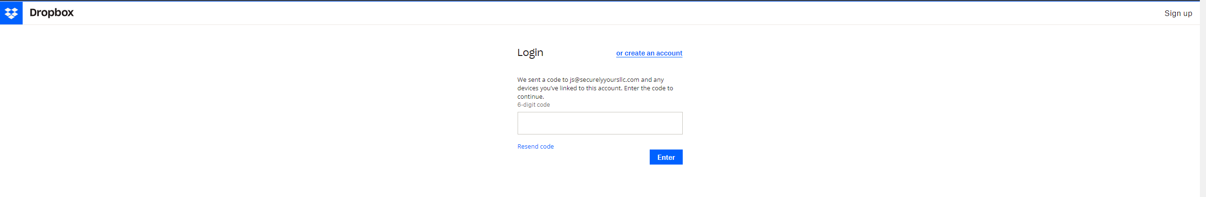
Backup Server - Dropbox

Slide 6
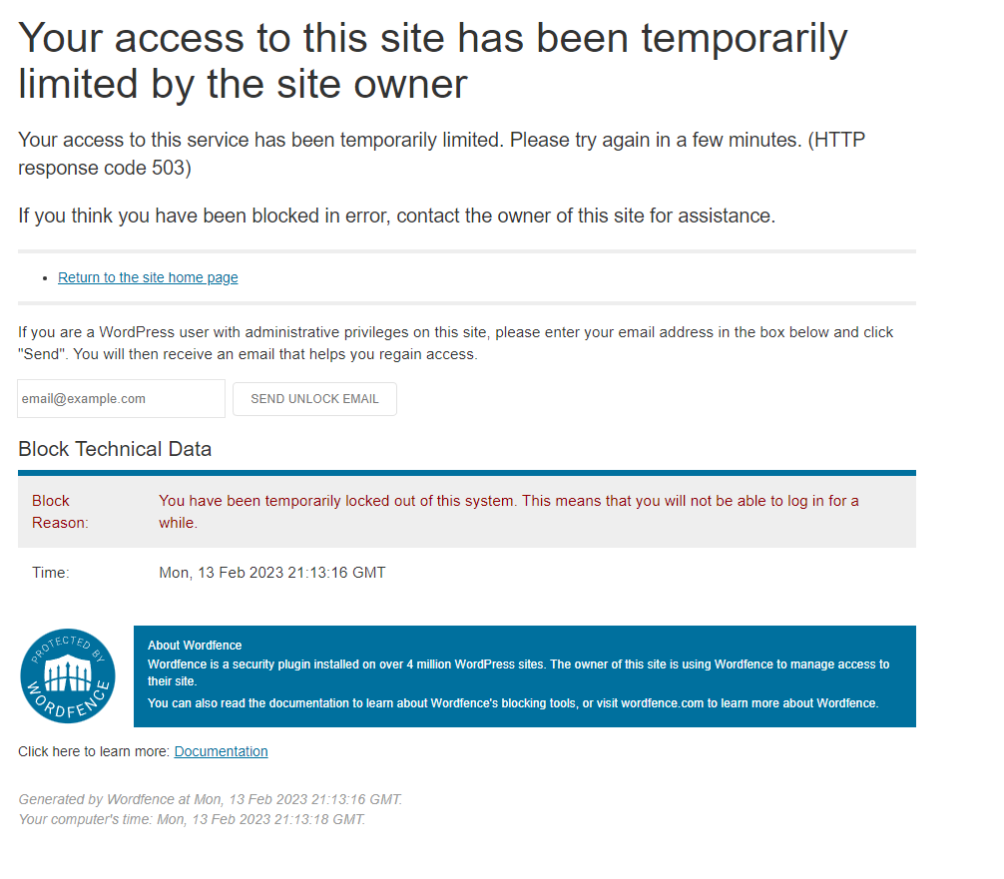
Email Server?

Slide 7
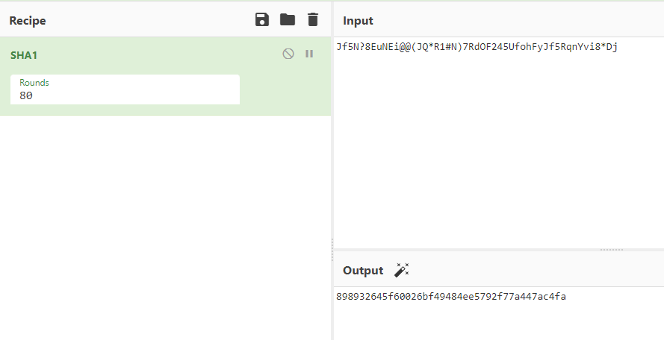
Backup Server – Password/Hash

Slide 8
Methods
All SHA-1 hashes (except one) easily found in public databases, used open-source program to run the hashes through the public databases, and used private tool to verify the password with the hash
Backup server hash tried to bruteforce, used a piece of software I previously made to do so, however it was taking multiple days and not much progress was being made. I eventually turned to public tools such as Hashcat, John the Ripper/Johnny, and Hash Suite
I noticed that one of the accounts had an email associated with it and it was a Dropbox account, so I logged in with it, however, 2FA was enabled on it, which is where I believe the password would have been stored in but could not gain access
I eventually found a semi-public/private passwords and character combinations ‘database’ with and was able to retrieve the password

Slide 9
Passwords

Slide 10
Securing your passwords – Method 1
Vaultwarden – A bitwarden locally hosted instance
Incredibly secure
Hosted locally
Can deny any outside use
Great for users to store company passwords (employees should not be storing private/personal passwords)
Organizational setup and access/user access and control
Free

Slide 11
Securing your passwords – General
Do not physically write any passwords down, and especially do not store them on/in/around your desk (Sticky notes!)
Use secure passwords
8+ characters, special symbols, numbers, capitals, no personal information in the password (use random characters)
Do not reuse passwords
Do not tell anyone your password

Slide 12
Securing your passwords – 2FA/MFA/Security keys
2 factor authentication, and multi-factor authentication
Things that allow for 2FA or MFA should be done and used
Add MFA to internal tools, combine password with email or text/call, use authenticator apps
When using RFID/NFC for access to buildings make sure to use secure forms of it
Internal tools which are high risk should use hardware security keys to allow access

